Slide 1
Chapter 2: Entity-Relationship Model
Lecture 03 CSE-223: Database Management System
Shamima Nasrin Daisy
Asst. Prof
Dept Of CSE
SBPGC

Slide 2
Chapter 6: Entity-Relationship Model
Design Process
Modeling
Constraints
E-R Diagram
Design Issues
Weak Entity Sets
Extended E-R Features
Design of the Bank Database
Reduction to Relation Schemas
Database Design
UML

Slide 3
Modeling
A database can be modeled as:
a collection of entities,
relationship among entities.
An entity is an object that exists and is distinguishable from other objects.
Example: specific person, company, event, plant
Entities have attributes
Example: people have names and addresses
An entity set is a set of entities of the same type that share the same properties.
Example: set of all persons, companies, trees, holidays
Entity, Entity Type, Entity Set –
An Entity is an object of Entity Type and a set of all entities is called as an entity set. e.g.; E1 is an entity having Entity Type Student and set of all students is called Entity Set. In ER diagram.

Slide 4
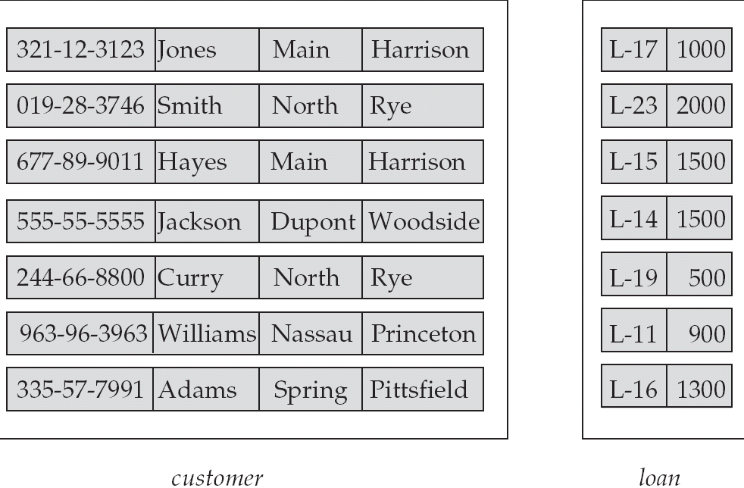
Entity Sets customer and loan
customer_id customer customer customer loan amount name street city number

Slide 5
Attributes
An entity is represented by a set of attributes, that is descriptive properties possessed by all members of an entity set.
Domain – the set of permitted values for each attribute
Attribute types:
Simple and composite attributes.
Single-valued and multi-valued attributes
Example: multivalued attribute: phone_numbers
Derived attributes
Can be computed from other attributes
Example: age, given date_of_birth
Example:
customer = (customer_id, customer_name, customer_street, customer_city )
loan = (loan_number, amount )

Slide 6
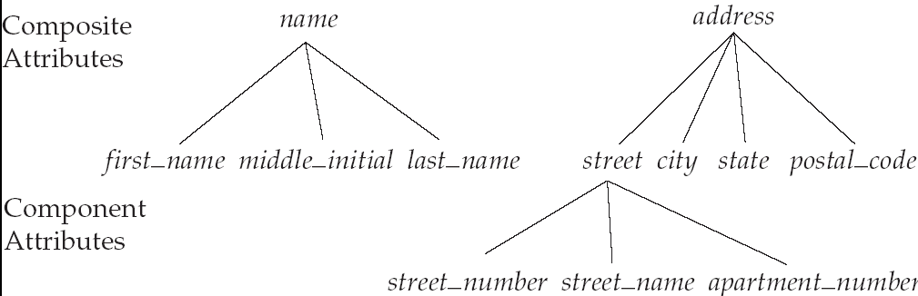
Composite Attributes

Slide 7
Relationship Sets
A relationship is an association among several entities
Example: Hayes depositor A-102 customer entity relationship set account entity
A relationship set is a mathematical relation among n ≥ 2 entities, each taken from entity sets
{(e₁, e₂, … e_{n}) | e₁ ∈ E₁, e₂ ∈ E₂, …, e_{n} ∈ E_{n}} where (e₁, e₂, …, e_{n}) is a relationship
Example:
(Hayes, A-102) ∈ depositor

Slide 8
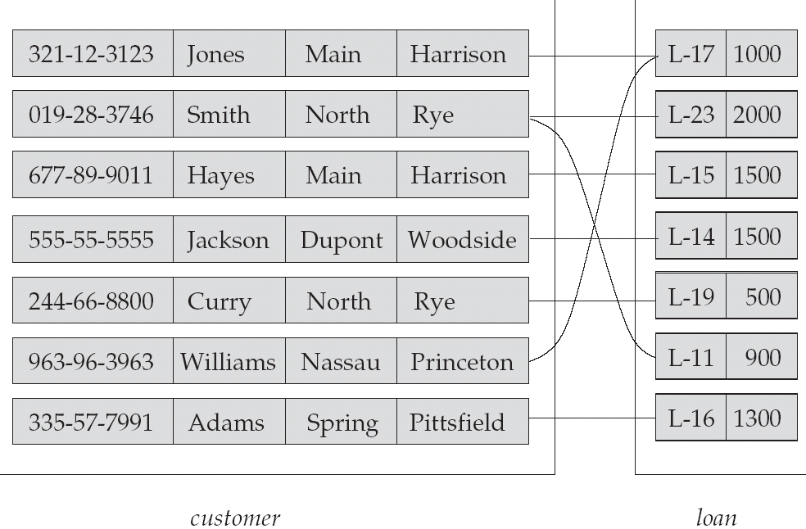
Relationship Set borrower

Slide 9
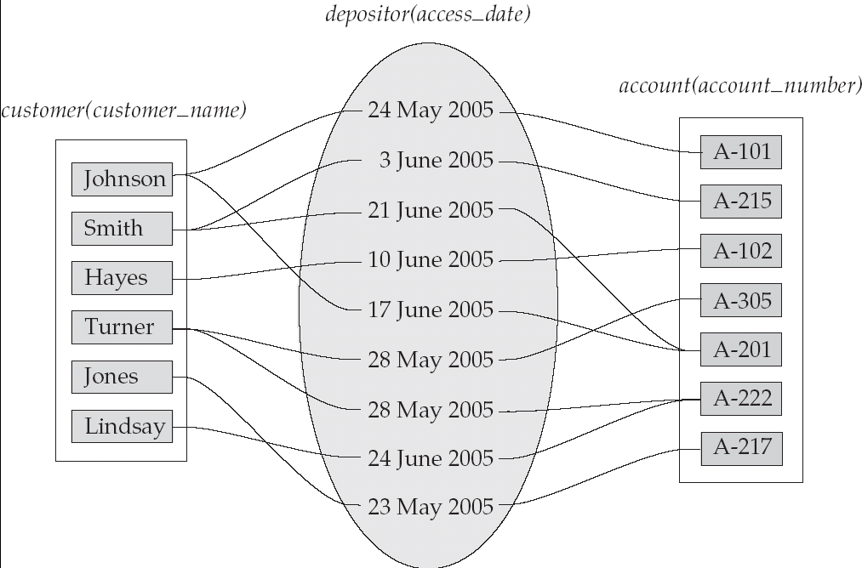
Relationship Sets (Cont.)
An attribute can also be property of a relationship set.
For instance, the depositor relationship set between entity sets customer and account may have the attribute access-date

Slide 10
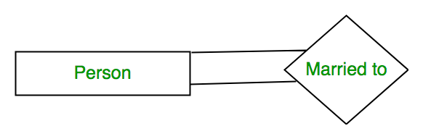
Degree of Relationship
A set of relationships of the same type is known as a relationship set. The following relationship set depicts S1 as enrolled in C2, S2 is enrolled in C1, and S3 is enrolled in C3.
Degree of a relationship set:
The number of different entity sets participating in a relationship set is called as the degree of a relationship set.
1. Unary Relationship – When there is only ONE entity set participating in a relation, the relationship is called a unary relationship. For example, one person is married to only one person.

Slide 11
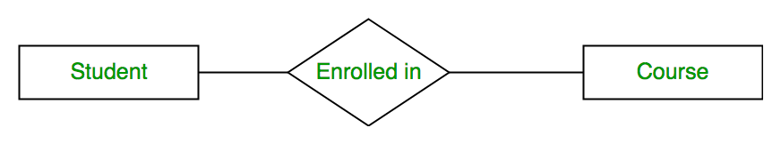
Degree of Relationship cot..
2. Binary Relationship –
When there are TWO entities set participating in a relationship, the relationship is called a binary relationship. For example, a Student is enrolled in a Course.
er11
3. n-ary Relationship –
When there are n entities set participating in a relation, the relationship is called an an n-ary relationship.
Cardinality:
The number of times an entity of an entity set participates in a relationship set is known as cardinality. Cardinality can be of different types:

Slide 12
Mapping Cardinality Constraints
Express the number of entities to which another entity can be associated via a relationship set.
Most useful in describing binary relationship sets.
For a binary relationship set the mapping cardinality must be one of the following types:
One to one
One to many
Many to one
Many to many

Slide 13


Type of Relationship
a. One-to-One Relationship
When only one instance of an entity is associated with the relationship, then it is known as one to one relationship.
For example, A female can marry to one male, and a male can marry to one female.
b. One-to-many relationship
When only one instance of the entity on the left, and more than one instance of an entity on the right associates with the relationship then this is known as a one-to-many relationship.
For example, Scientist can invent many inventions, but the invention is done by the only specific scientist.

Slide 14


Type of Relationship cont..
c. Many-to-one relationship
When more than one instance of the entity on the left, and only one instance of an entity on the right associates with the relationship then it is known as a many-to-one relationship.
For example, Student enrolls for only one course, but a course can have many students.
Fig: Many to one
d. Many-to-many relationship
When more than one instance of the entity on the left, and more than one instance of an entity on the right associates with the relationship then it is known as a many-to-many relationship.
For example, Employee can assign by many projects and project can have many employees.
Fig: Many to Many

Slide 15
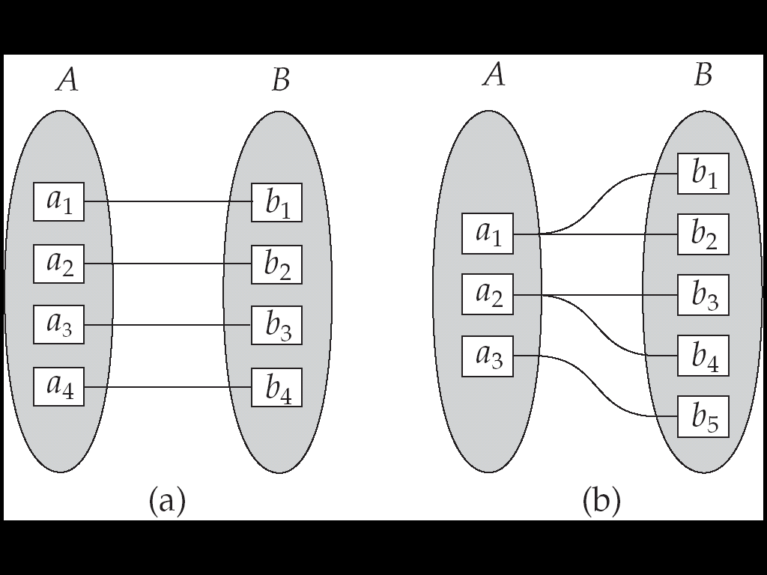
Mapping Cardinalities
One to one
One to many
Note: Some elements in A and B may not be mapped to any elements in the other set

Slide 16
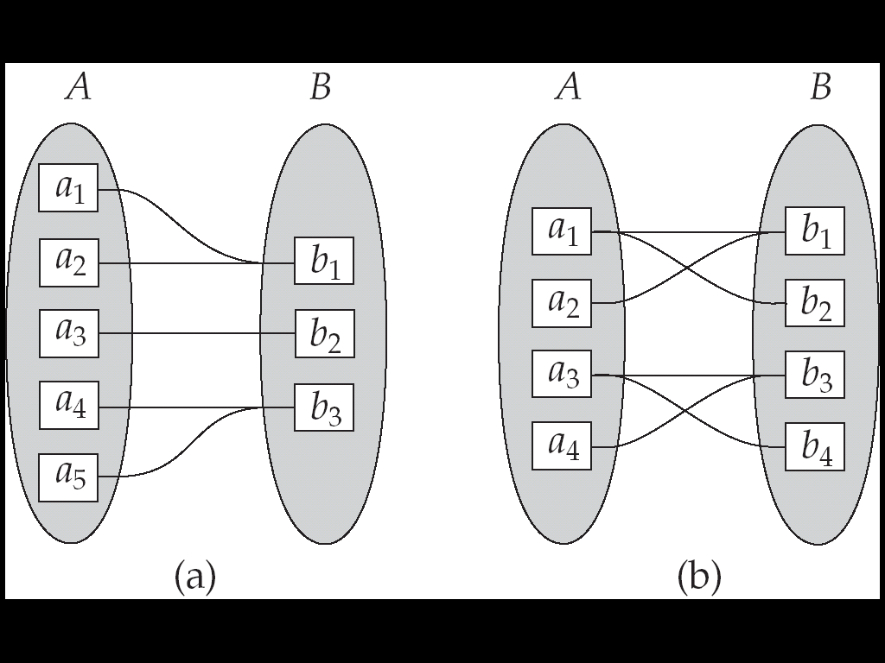
Mapping Cardinalities
Many to one
Many to many
Note: Some elements in A and B may not be mapped to any
elements in the other set

Slide 17
Keys
A super key of an entity set is a set of one or more attributes whose values uniquely determine each entity.
{ customer_id } , { customer_id , customer_name } ,
{customer_name, customer_street}
A candidate key of an entity set is a minimal super key. [ No proper subset of a candidate key is a super key]
{ customer_id } and {customer_name, customer_street} are candidate key but { customer_id , customer_name } is not a candidate key because customer_id is itself a superkey.
Primary key is selected from one of the candidate keys by the database designer as the principal means of identifying entities within an entity set.
Foreign key: is a field (or collection of fields) in one table, that refers to the PRIMARY KEY in another table.

Slide 18
Keys for Relationship Sets
The combination of primary keys of the participating entity sets forms a super key of a relationship set.
(customer_id, account_number) is the super key of depositor
Need to consider semantics of relationship set in selecting the primary key in case of more than one candidate key
DBMS Keys: Primary, Foreign, Candidate and Super Key - javatpoint

Slide 19
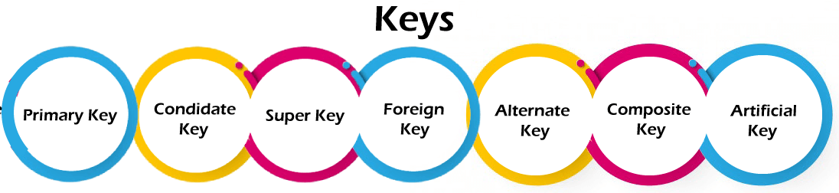
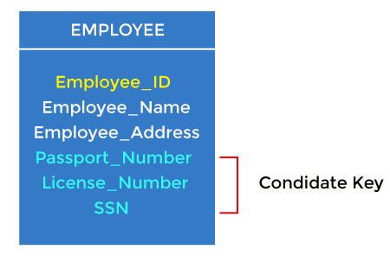
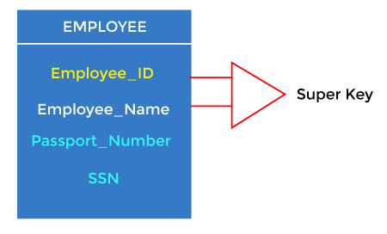
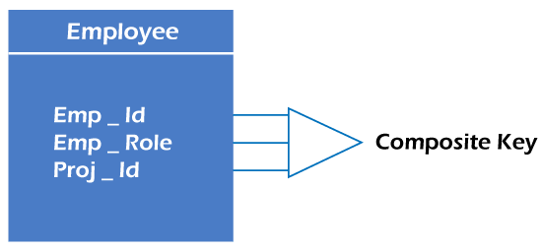
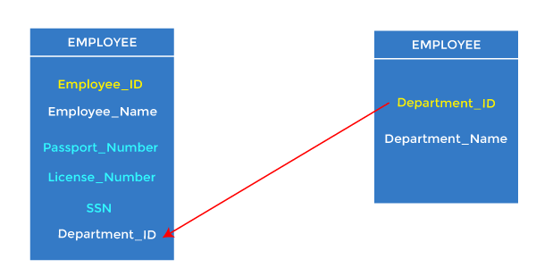
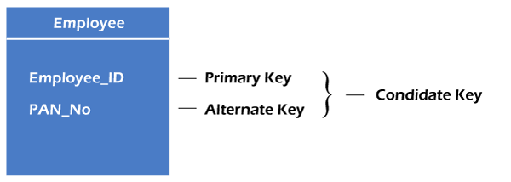
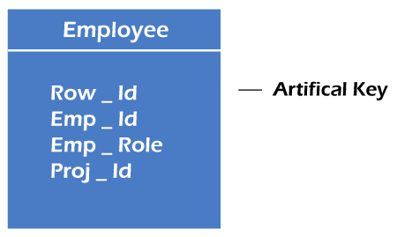

Slide 20
Degree of a Relationship Set
Refers to number of entity sets that participate in a relationship set.
Relationship sets that involve two entity sets are binary (or degree two).
Relationship sets may involve more than two entity sets.
Relationships between more than two entity sets are rare. Most relationships are binary.
Example: Suppose employees of a bank may have jobs (responsibilities) at multiple branches, with different jobs at different branches. Then there is a ternary relationship set between entity sets employee, job, and branch

Slide 21
Entity Sets vs Attributes
Consider the entity set employee with attributes employee-name and telephone-number. It can easily be argued that a telephone is an entity in its own right with attributes telephone-number and location.
• The employee entity set with attribute employee-name
• The telephone entity set with attributes telephone-number and location
• The relationship set emp-telephone denotes the association between employees and the telephones that they have

Slide 22
Entity Sets vs Relationship Sets
An object may be expressed by an entity set or a relationship set.
- A bank loan can be modeled as an entity.
- An alternative is to model a loan not as an entity, but rather as a relationship between customers and branches, with loan-number and amount as descriptive attributes. Each loan is represented by a relationship between a customer and a branch.

Slide 23
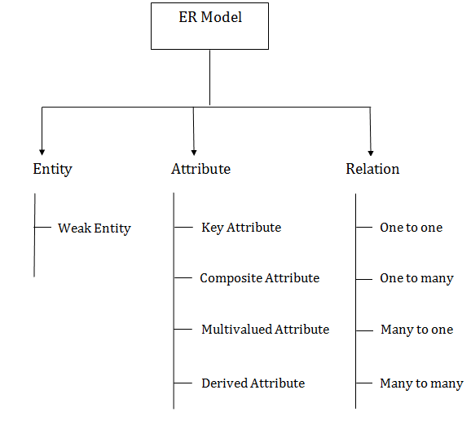
Strong Entity

Slide 24
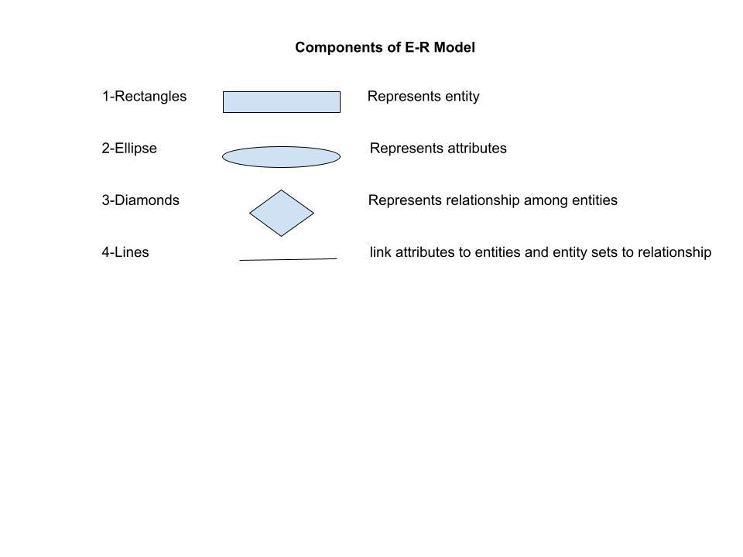
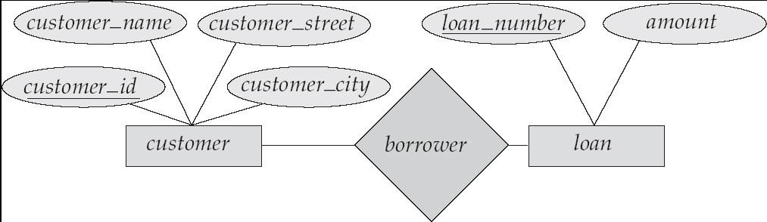

Slide 25
E-R Diagrams
Rectangles represents entity sets
Double rectangles represents weak entity sets
Ellipses represents attributes
Underlined ellipses represents primary key
Double ellipses represents multivalued attributes
Dashed ellipses denotes derived attributes
Diamonds represents relationship sets
Lines links attributes to entity sets and entity sets to relationship sets
Double lines indicate total participation of an entity in a relationship set

Slide 26
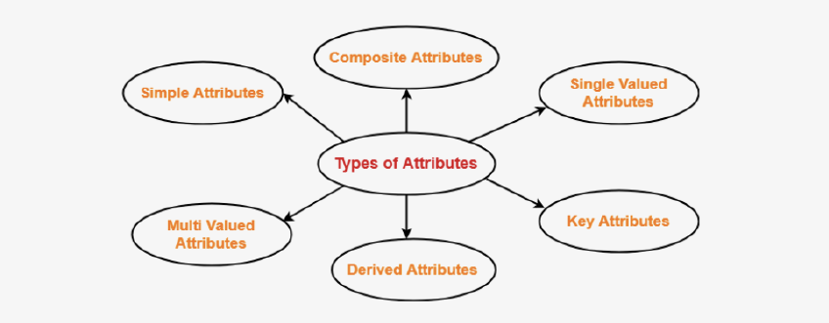
Types of Attributes

Slide 27
See the URL
1. Simple Attributes
https://www.javatpoint.com/dbms-er-model-concept

Slide 28
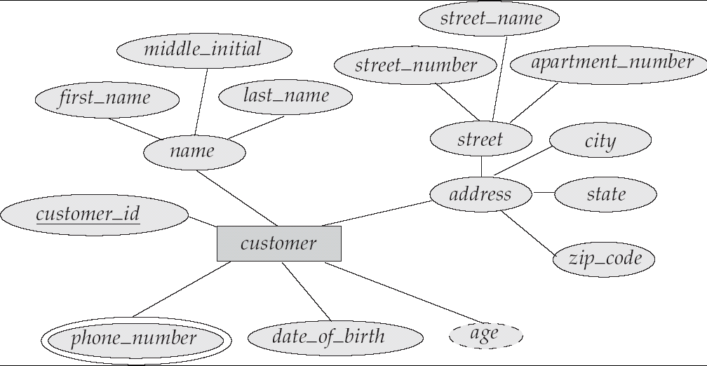
E-R Diagram With Composite, Multivalued, and Derived Attributes

Slide 29
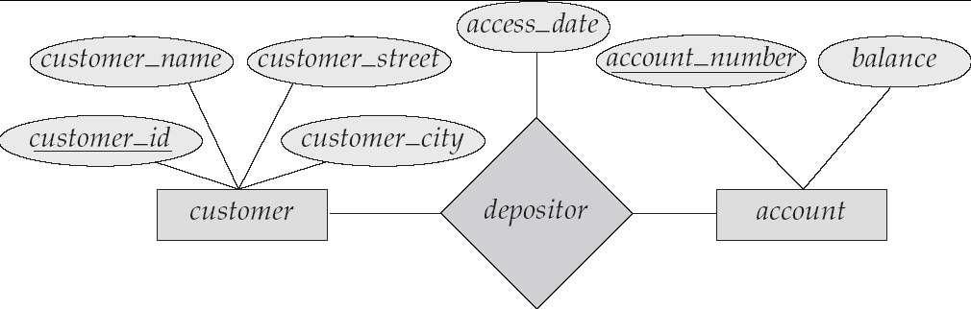
Relationship Sets with Attributes

Slide 30
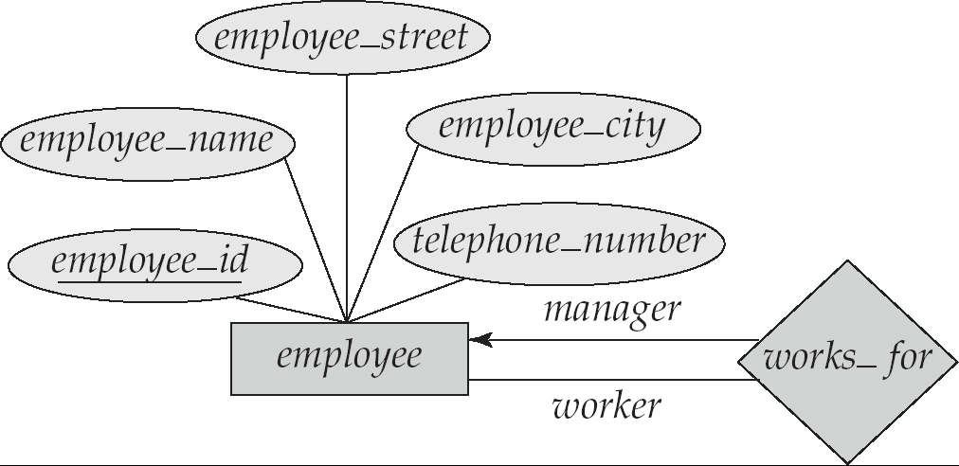
Roles
Entity sets of a relationship need not be distinct
The labels “manager” and “worker” are called roles; they specify how employee entities interact via the works_for relationship set.
Roles are indicated in E-R diagrams by labeling the lines that connect diamonds to rectangles.
Role labels are optional, and are used to clarify semantics of the relationship

Slide 31
Cardinality Constraints
We express cardinality constraints by drawing either a directed line (→), signifying “one,” or an undirected line (—), signifying “many,” between the relationship set and the entity set.
One-to-one relationship:
A customer is associated with at most one loan via the relationship borrower
A loan is associated with at most one customer via borrower

Slide 32
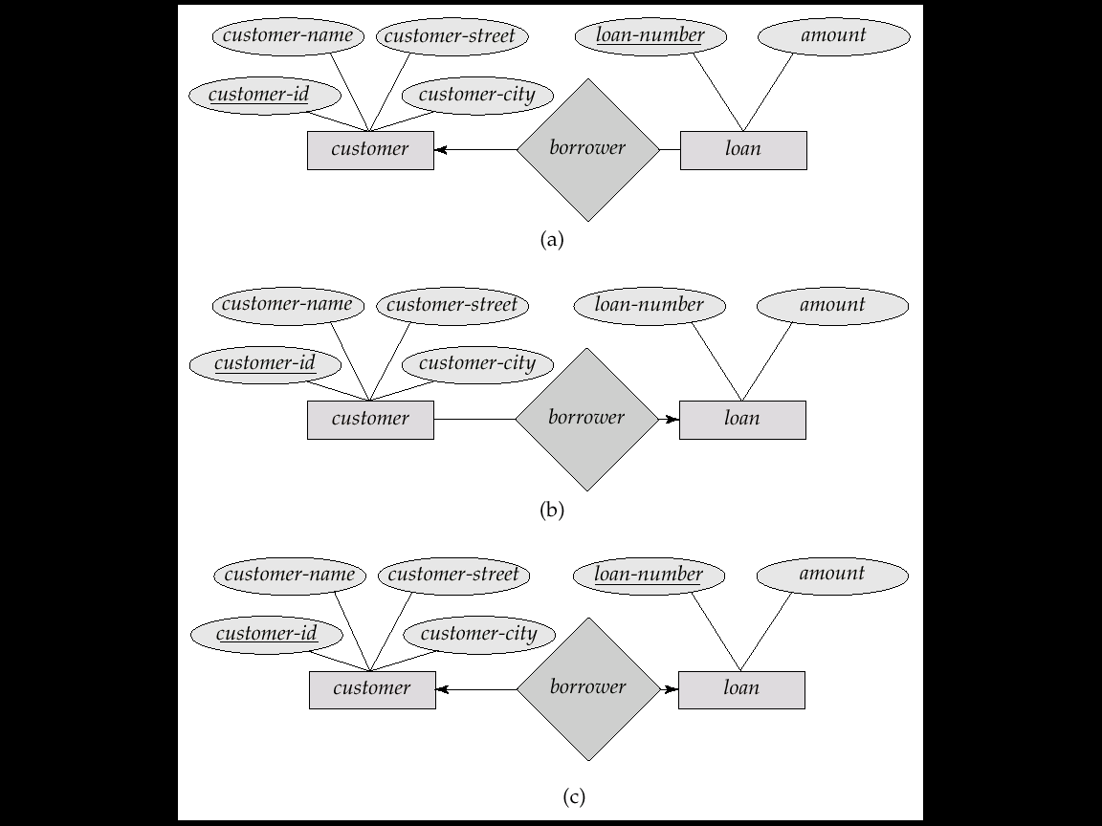
One-To-Many Relationship
In the one-to-many relationship a loan is associated with at most one customer via borrower, a customer is associated with several (including 0) loans via borrower
[one customer many loan]

Slide 33
Many-To-One Relationships
In a many-to-one relationship a loan is associated with several (including 0) customers via borrower, a customer is associated with at most one loan via borrower
[one loan many customer]

Slide 34
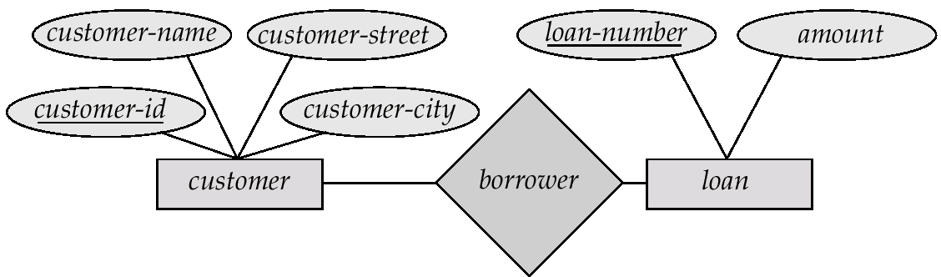
Many-To-Many Relationship
A customer is associated with several (possibly 0) loans via borrower
A loan is associated with several (possibly 0) customers via borrower

Slide 35
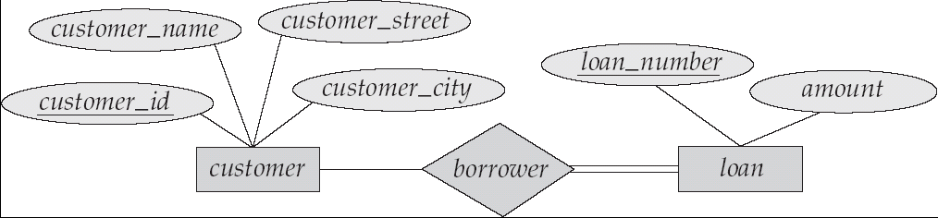
Participation of an Entity Set in a Relationship Set
Total participation (indicated by double line): every entity in the entity set participates in at least one relationship in the relationship set
E.g. participation of loan in borrower is total that means every loan must have a customer associated to it via borrower
Partial participation: some entities may not participate in any relationship in the relationship set
Example: participation of customer in borrower is partial

Slide 36
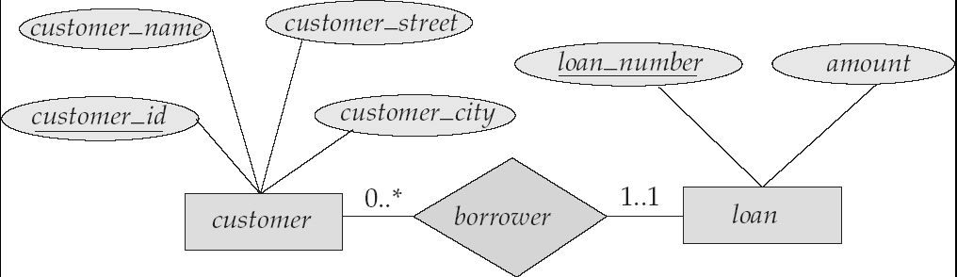
Alternative Notation for Cardinality Limits
Cardinality limits can also express participation constraints in l..h form where l is the minimum and h the maximum cardinality.
A minimum value of 1 indicates total participation of the entity set in the relationship set.
A maximum value of 1 indicates that the entity participates in at most one relationship, while a maximum value ∗ indicates no limit.
Practice from book

Slide 37
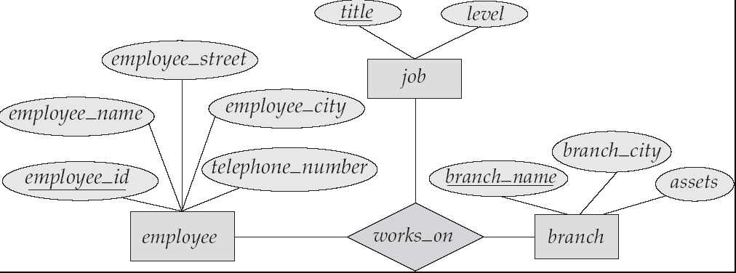
E-R Diagram with a Ternary Relationship

Slide 38
Weak Entity Sets
An entity set that does not have a primary key is referred to as a weak entity set.
The existence of a weak entity set depends on the existence of a identifying entity set
it must relate to the identifying entity set via a total, one-to-many relationship set from the identifying to the weak entity set
Identifying relationship depicted using a double diamond
The discriminator (or partial key) of a weak entity set is the set of attributes that distinguishes among all the entities of a weak entity set.
The primary key of a weak entity set is formed by the primary key of the strong entity set on which the weak entity set is existence dependent, plus the weak entity set’s discriminator.

Slide 39
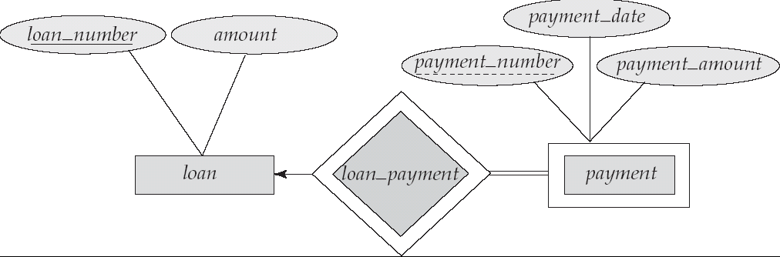
Weak Entity Sets (cont.)
We depict a weak entity set by double rectangles.
We underline the discriminator of a weak entity set with a dashed line.
payment_number – discriminator of the payment entity set
Primary key for payment – (loan_number, payment_number)

Slide 40
Weak Entity Sets (Cont.)
Note: the primary key of the strong entity set is not explicitly stored with the weak entity set, since it is implicit in the identifying relationship.
If loan_number were explicitly stored, payment could be made a strong entity, but then the relationship between payment and loan would be duplicated by an implicit relationship defined by the attribute loan_number common to payment and loan

Slide 41
More Weak Entity Set Examples
In a university, a course is a strong entity and a course_offering can be modeled as a weak entity
The discriminator of course_offering would be semester (including year) and section_number (if there is more than one section)
If we model course_offering as a strong entity we would model course_number as an attribute.
Then the relationship with course would be implicit in the course_number attribute

Slide 42
Extended E-R Features: Specialization
Top-down design process; we designate subgroupings within an entity set that are distinctive from other entities in the set.
These subgroupings become lower-level entity sets that have attributes or participate in relationships that do not apply to the higher-level entity set.
Depicted by a triangle component labeled ISA (E.g. customer “is a” person).
Attribute inheritance – a lower-level entity set inherits all the attributes and relationship participation of the higher-level entity set to which it is linked.

Slide 43
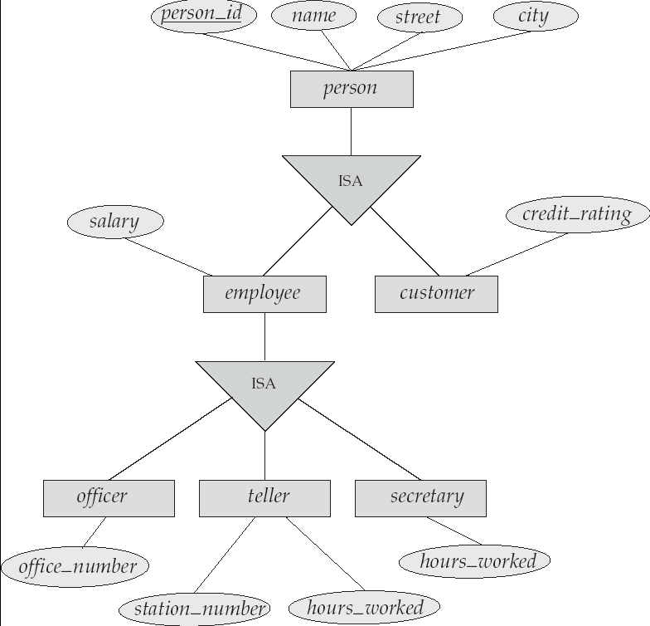
Specialization Example

Slide 44
Extended ER Features: Generalization
A bottom-up design process – combine a number of entity sets that share the same features into a higher-level entity set.
Specialization and generalization are simple inversions of each other; they are represented in an E-R diagram in the same way.
The terms specialization and generalization are used interchangeably.

Slide 45
Specialization and Generalization (Cont.)
Can have multiple specializations of an entity set based on different features.
E.g. permanent_employee vs. temporary_employee, in addition to officer vs. secretary vs. teller
Each particular employee would be
a member of one of permanent_employee or temporary_employee,
and also a member of one of officer, secretary, or teller
The ISA relationship also referred to as superclass - subclass relationship

Slide 46
Design Constraints on a Specialization/Generalization
Constraint on which entities can be members of a given lower-level entity set.
condition-defined
Example: all customers over 65 years are members of senior-citizen entity set; senior-citizen ISA person.
user-defined
Constraint on whether or not entities may belong to more than one lower-level entity set within a single generalization.
Disjoint
an entity can belong to only one lower-level entity set
Noted in E-R diagram by writing disjoint next to the ISA triangle
Overlapping
an entity can belong to more than one lower-level entity set

Slide 47
Design Constraints on a Specialization/Generalization (Cont.)
Completeness constraint -- specifies whether or not an entity in the higher-level entity set must belong to at least one of the lower-level entity sets within a generalization.
total : an entity must belong to one of the lower-level entity sets
partial: an entity need not belong to one of the lower-level entity sets

Slide 48
Limitation of ER model
One limitation of the E-R model is that it can not express relationship among relationship.
We can overcome this limitation by using Aggregation

Slide 49
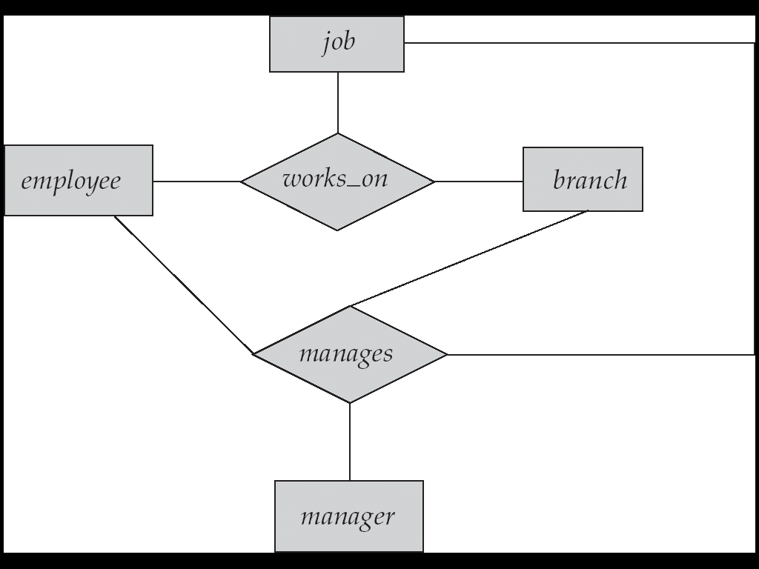
Aggregation
In aggregation, the relation between two entities is treated as a single entity. In aggregation, relationship with its corresponding entities is aggregated into a higher level entity.
Consider the ternary relationship works_on, which we saw earlier
Suppose we want to record managers for tasks performed by an employee at a branch

Slide 50
Aggregation (Cont.)
Relationship sets works_on and manages represent overlapping information
Every manages relationship corresponds to a works_on relationship
However, some works_on relationships may not correspond to any manages relationships
So we can’t discard the works_on relationship
Eliminate this redundancy via aggregation
Treat relationship as an abstract entity
Allows relationships between relationships
Abstraction of relationship into new entity
Without introducing redundancy, the following diagram represents:
An employee works on a particular job at a particular branch
An employee, branch, job combination may have an associated manager

Slide 51
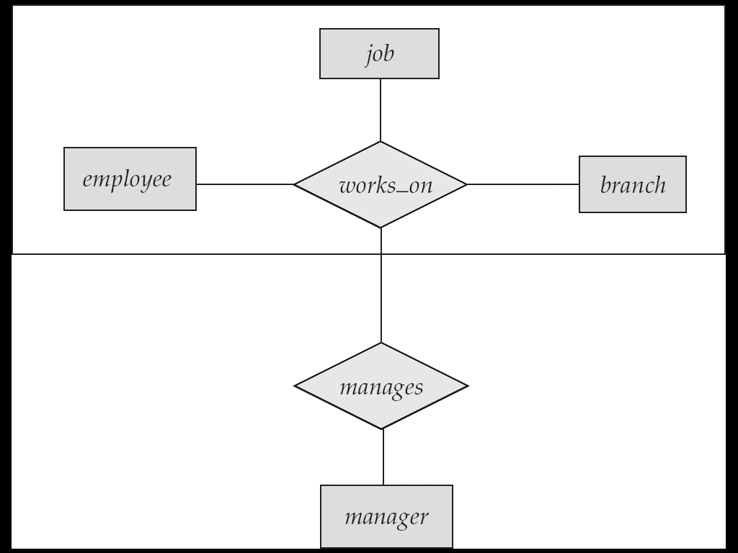
E-R Diagram With Aggregation

Slide 52
E-R Design Decisions
The use of an attribute or entity set to represent an object.
Whether a real-world concept is best expressed by an entity set or a relationship set.
The use of a ternary relationship versus a pair of binary relationships.
The use of a strong or weak entity set.
The use of specialization/generalization – contributes to modularity in the design.
The use of aggregation – can treat the aggregate entity set as a single unit without concern for the details of its internal structure.

Slide 53
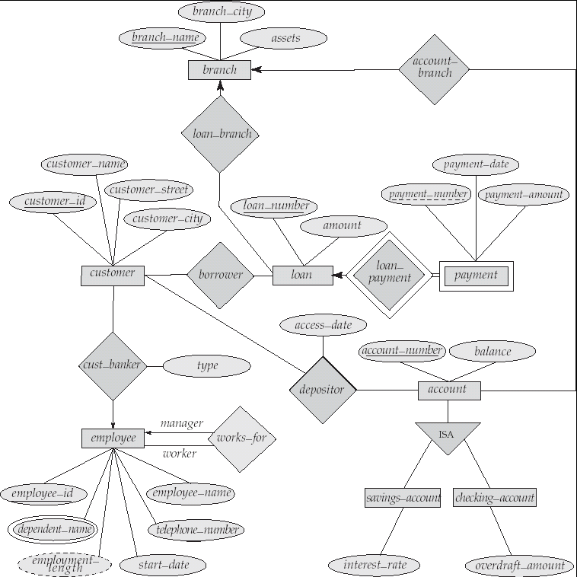
E-R Diagram for a Banking Enterprise

Slide 54
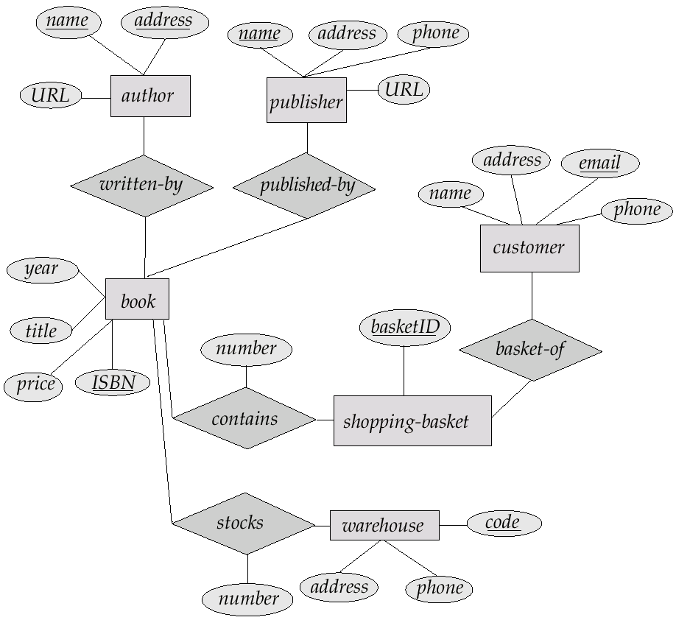
E-R Diagram for Exercise

Slide 55
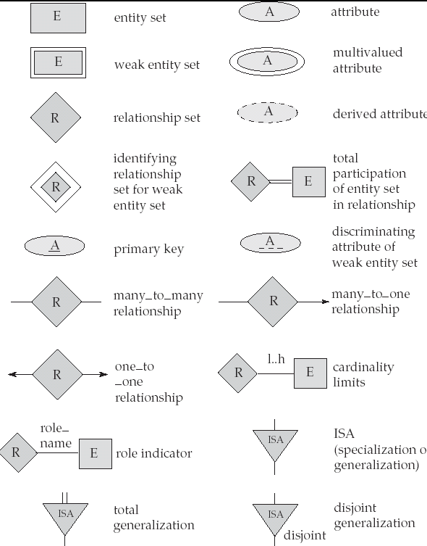
Summary of Symbols Used in E-R Notation

Slide 56
UML
Unified Modeling Language (UML) helps to model the data representation of ER diagram by component of a software system. Some of the parts of UML are:
Class diagram: A class diagram is similar to an E-R diagram.
Use case diagram: Use case diagrams show the interaction between users and
the system, in particular the steps of tasks that users perform.
Activity diagram: Activity diagrams depict the flow of tasks between various
components of a system.
Implementation diagram: Implementation diagrams show the system components and their interconnections, both at the software component level and the hardware component level.

Slide 57
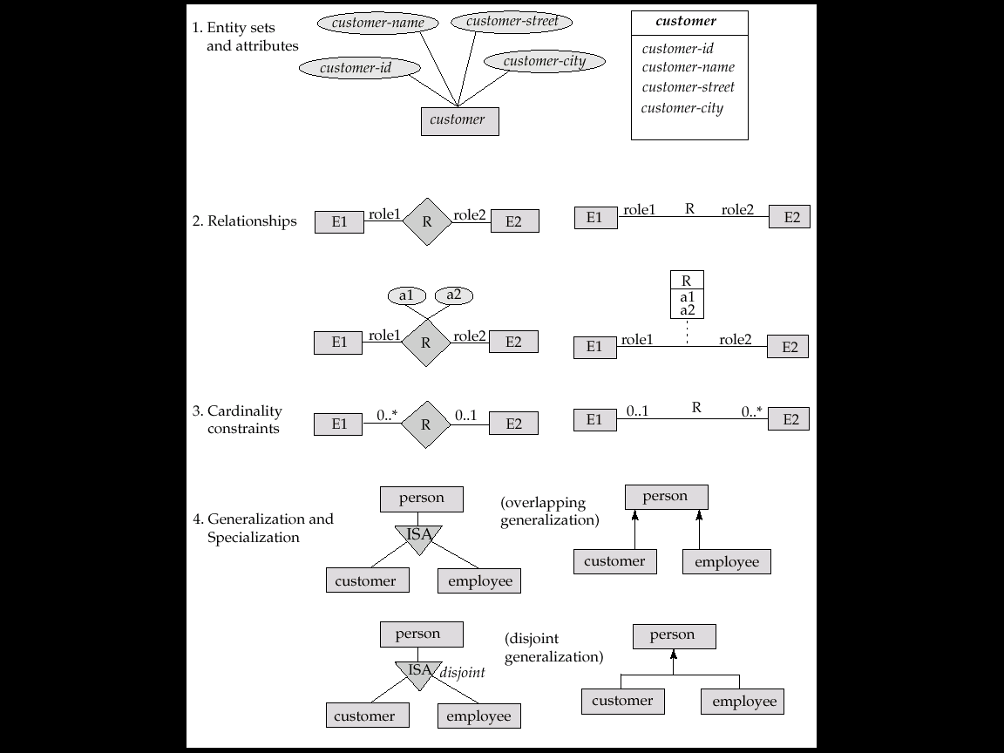
UML Class Diagram Notation

Slide 58
UML Class Diagram Notation
overlapping
disjoint
*Generalization can use merged or separate arrows independent of disjoint/overlapping

Slide 59
Any Question?

Slide 60
Thank You

